Slide 1
Data Storytelling
DC Traffic Violations: 2018-2020

Slide 2
Questions
What percentage of DC traffic tickets are automatic?
Count? Revenue?
Are there any trends overtime?
Does the introduction of a speed camera lead to a bunch of tickets initially, then level off?
Do some wards see more automatic traffic violations than others?
Do some wards see a greater proportion of extremely high speed violations that others?

Slide 3
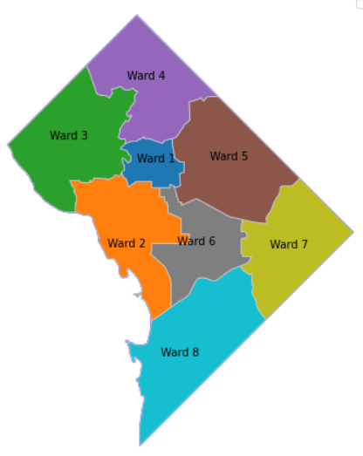
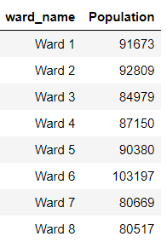
Washington DC’s 8 Wards
Ward Map
Ward Populations 2021

Slide 4
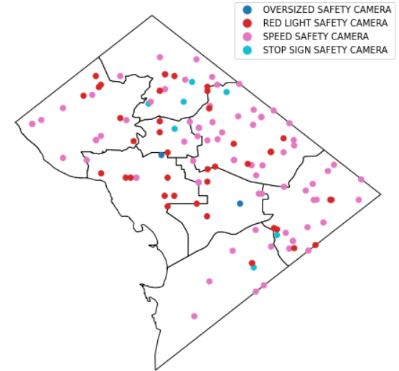
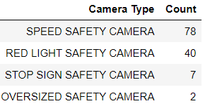
Automated Traffic Cameras
Camera Locations
Camera Type Counts

Slide 5
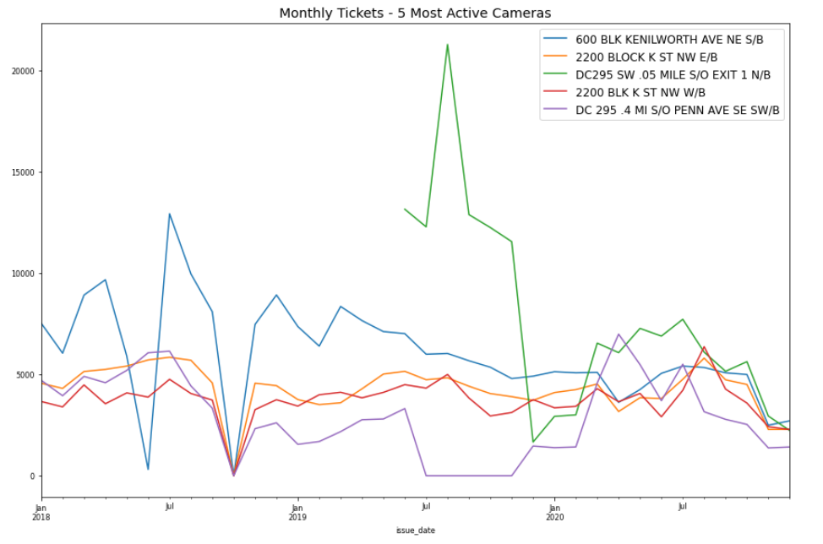
Huge Spike in tickets at DC 295 Exit 1 when it is introduced summer 2019
*Missing October 2018 Data

Slide 6
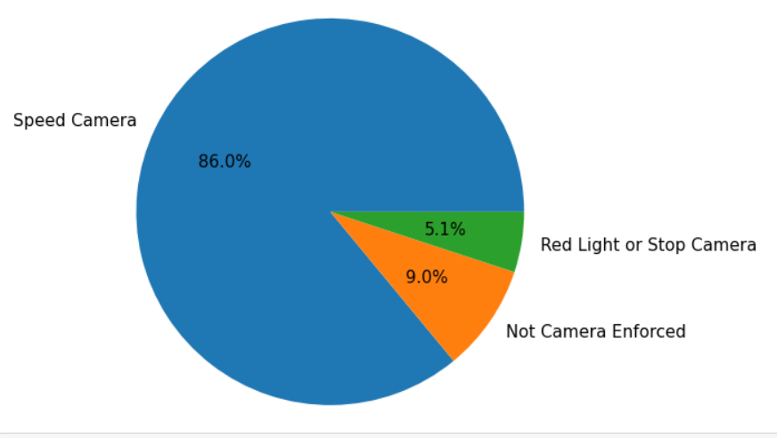
DC Moving Violations 2018-2020
Automated tickets make up the majority of traffic tickets in DC
*Missing October 2018 Data

Slide 7
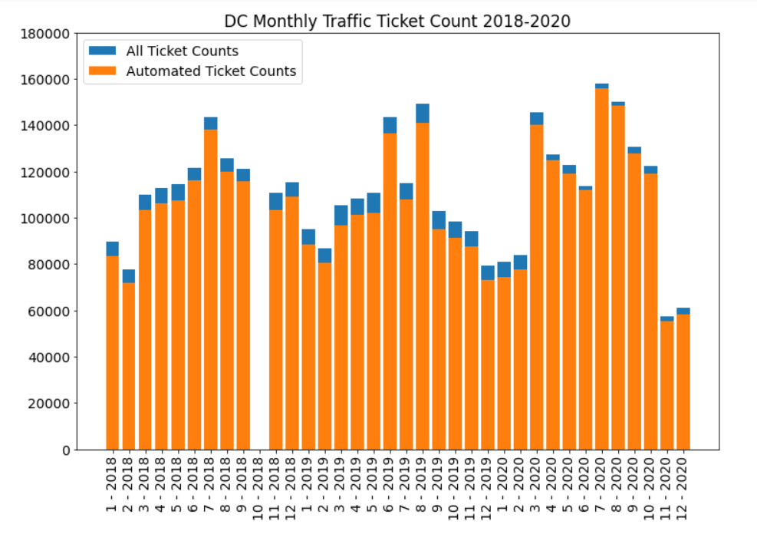
Reduction of non-automatic tickets share with start of COVID-19 Pandemic (post March 2020)
Lowest ticket # overall – due to less traffic? Or less enforcement?
*Missing October 2018 Data

Slide 8
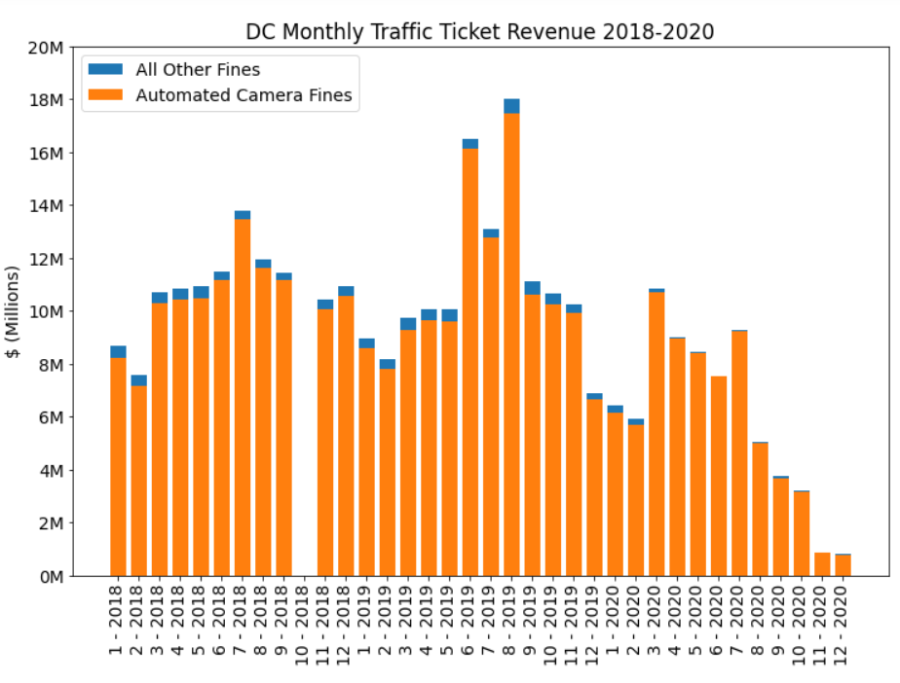
Much lower revenue during the pandemic– perhaps due to policy change?
*Missing October 2018 Data

Slide 9
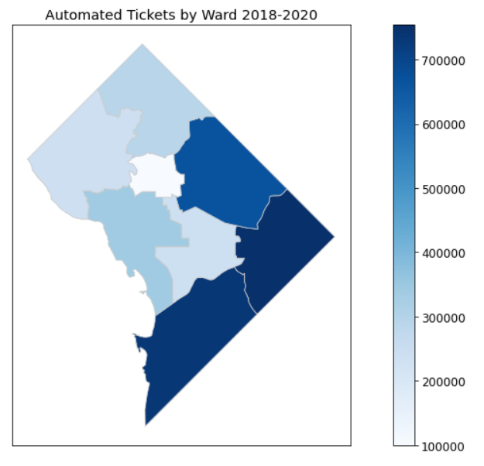
Wards 7, 8 & 5 see the most automated tickets
*Missing October 2018 Data

Slide 10
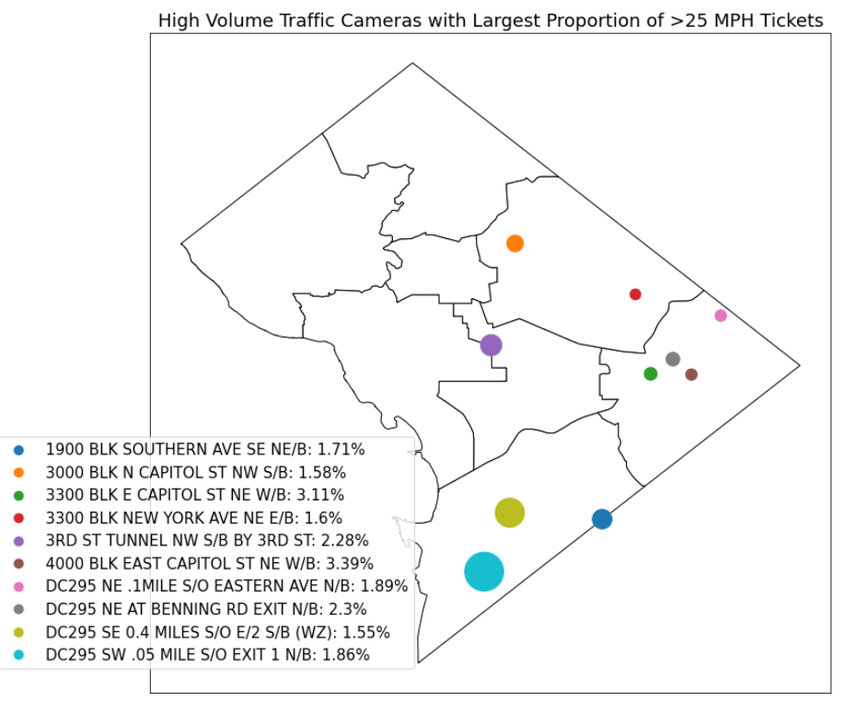
Size of circles indicates # of tickets at that location
Cameras with highest proportion of >25 MPH tickets mostly in Wards 7, 8 & 5

Slide 11
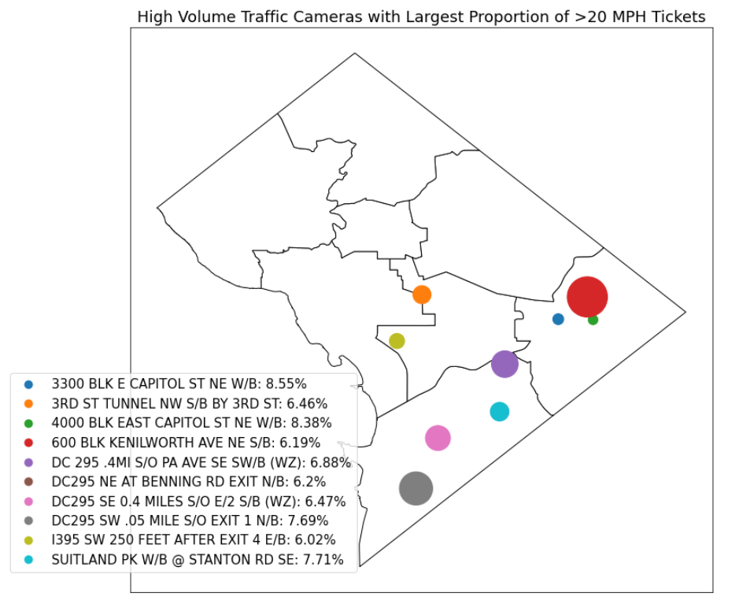
Size of circles indicates # of tickets at that location
Cameras with highest proportion of >20 MPH tickets are in Wards 7 & 8

